Slide 1


Introduction to Phylogenetics in Bioinformatics
Phylogenetics in bioinformatics is the study of evolutionary relationships among biological entities, including genes, species, and populations. It utilizes computational and statistical methods to analyze molecular data and construct evolutionary trees, enabling researchers to understand the genetic connections and divergence patterns.
By examining DNA, RNA, and protein sequences, scientists can infer common ancestors, genetic mutations, and evolutionary processes. This field plays a crucial role in understanding biodiversity, genetic diseases, and the evolutionary history of organisms. With its applications in systematics, comparative genomics, and evolutionary biology, phylogenetics is a cornerstone of bioinformatics research.

Slide 2
Basics of Evolutionary Relationships
Evolutionary relationships in biology refer to the connections between different species and their shared evolutionary history. It involves understanding how species have evolved from common ancestors and how they are related to each other through genetic and phenotypic similarities. These relationships are crucial for studying the diversification of life on Earth and for understanding the mechanisms driving evolutionary change.
By analyzing the genetic sequences and traits of different organisms, researchers can reconstruct the evolutionary pathways and create phylogenetic trees to visualize these relationships. This helps in identifying patterns of speciation, adaptation, and extinction, providing insights into the fundamental processes that have shaped the biodiversity we observe today.
Understanding the basics of evolutionary relationships is essential for various fields, including ecology, conservation biology, and evolutionary genetics. It provides a framework for studying the interconnectedness of life forms and the processes that have led to the incredible diversity of living organisms on our planet.
Exploring evolutionary relationships through phylogenetics not only sheds light on the past but also plays a crucial role in predicting and understanding future evolutionary trajectories and ecological interactions.

Slide 3

Phylogenetic Tree Construction Methods
Distance-based Methods
1
Distance-based methods are used to construct phylogenetic trees based on the genetic distance between sequences. They include Neighbor-Joining, which creates a tree by joining the closest sequences first, and UPGMA, which assumes a constant rate of evolution. These methods are suitable for large datasets but may not accurately represent complex evolutionary processes.
2
Character-based Methods
Character-based methods analyze specific characters or features within sequences to infer evolutionary relationships. Maximum Parsimony seeks to minimize the number of evolutionary changes required, while Maximum Likelihood uses statistical models to find the most likely tree. These methods are computationally intensive but provide more accurate results when evolutionary models are well understood.
Cladistics and Phylogenomics
3
Cladistics focuses on the identification of shared derived characteristics to group organisms, resulting in cladograms. Phylogenomics combines molecular data from genomics to reconstruct evolutionary relationships, leveraging whole genome sequences to create robust phylogenetic trees. These methods offer a comprehensive view of evolutionary history but require extensive computational resources and data analysis.

Slide 4
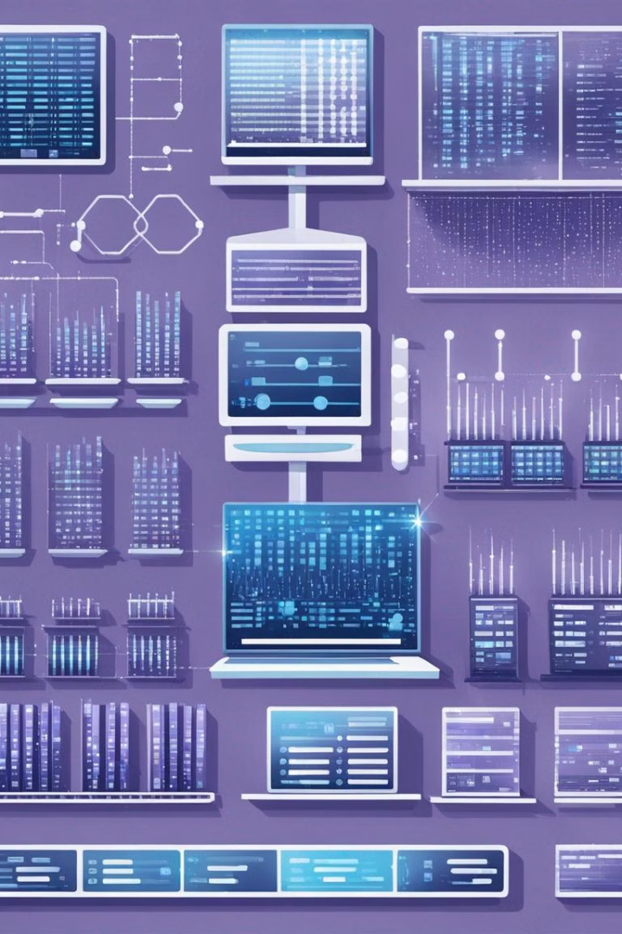
Sequence Alignment in Phylogenetics
Sequence alignment is a fundamental process in bioinformatics, essential for comparing DNA or protein sequences to identify similarities and differences. It involves aligning sequences to uncover evolutionary relationships, mutations, and structural characteristics. The process requires meticulous attention to detail and accuracy as it plays a crucial role in inferring phylogenetic relationships.
In the bright laboratory setting, scientists meticulously analyze multiple DNA sequences using powerful computational tools. The glow of computer screens illuminates the focused faces of researchers as they delve into the intricate details of sequence alignment, striving to reveal the hidden patterns within the genetic material.

Slide 5
Molecular Clock and Divergence Time Estimation
1
Molecular Clock Theory
Utilizes the rate of molecular change to estimate divergence times
Sequence Data Analysis
2
Comparing genetic sequences to infer evolutionary relationships
Phylogenetic Inference
3
Utilizing molecular data to construct phylogenetic trees for time estimation
The molecular clock theory is a fundamental concept in phylogenetics that uses the rate of molecular change to estimate the divergence times of different species or lineages. It is based on the assumption that DNA or protein sequences accumulate mutations at a constant rate over time. Sequence data analysis plays a crucial role in this process, as it involves comparing genetic sequences from different organisms to infer evolutionary relationships. Phylogenetic inference, using molecular data to construct phylogenetic trees, is essential for accurate time estimation within the evolutionary history of species. These methods are crucial for understanding the temporal aspects of evolutionary processes and the relationships between different organisms.

Slide 6


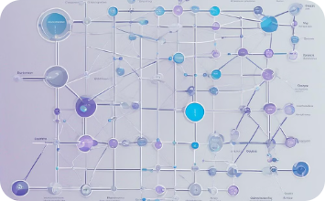
Applications of Phylogenetics in Bioinformatics
Collaborative Research
Genetic Variation Analysis
Network Analysis
Phylogenetics in bioinformatics fosters collaborative research, bringing together experts in genetics, statistics, and computer science. By analyzing genetic sequences and constructing phylogenetic trees, researchers solve complex evolutionary puzzles to understand the relationships between species and their genetic histories.
Through the study of phylogenetics, bioinformaticians analyze genetic variations and mutations in species, shedding light on evolutionary adaptation and population diversity. This aids in identifying genetic markers for disease susceptibility and exploring biodiversity for conservation efforts.
Phylogenetic network analysis in bioinformatics uncovers intricate relationships and genetic flow between species. This approach enables the study of horizontal gene transfer, hybridization, and reticulate evolution, providing insights into the dynamic nature of genetic information exchange among organisms.

Slide 7
Challenges in Phylogenetic Analysis
Data Quality: Ensuring the accuracy and completeness of the biological data used in phylogenetic analysis is a major challenge. The data often come from diverse sources with varying levels of reliability, leading to potential biases and errors in the analysis.
Computational Complexity: Phylogenetic analysis involves handling large datasets and complex algorithms, which can strain computational resources and require specialized expertise in bioinformatics and computational biology.
Modeling Assumptions: Choosing appropriate evolutionary models and assumptions for phylogenetic inference is a challenging task, as different models may yield varying results, and the true evolutionary process is often more complex than any single model can capture.
Interpretation of Results: Interpreting the results of phylogenetic analyses and understanding the uncertainty associated with inferred evolutionary relationships can be challenging, especially when dealing with conflicting signals or incomplete lineage sorting.

Slide 8
Tools and Software for Phylogenetic Analysis
Phylogenetic Software
Sequence Alignment Tools
Visualization Platforms
Statistical Analysis Software
There are various software tools available for phylogenetic analysis, each with its own strengths and applications. These tools include widely used programs like MEGA, PAUP*, MrBayes, and BEAST. They offer features such as sequence alignment, tree construction, and model selection, allowing researchers to perform complex phylogenetic analyses with ease.
Statistical packages such as R and Python with libraries like Bioconductor and Biopython provide a powerful platform for statistical analysis in phylogenetics. These tools enable users to implement advanced statistical models, conduct hypothesis testing, and perform rigorous statistical inference to validate phylogenetic results.
Tools like Clustal Omega, MUSCLE, and MAFFT play a crucial role in aligning DNA, RNA, and protein sequences for phylogenetic analysis. These alignment tools use sophisticated algorithms to identify homologous regions and establish evolutionary relationships, providing a foundation for constructing accurate phylogenetic trees.
Visualization tools like FigTree, iTOL, and Archaeopteryx are essential for interpreting phylogenetic trees and exploring evolutionary patterns. They allow users to customize tree layouts, annotate branches, and visualize sequence divergence, enabling clear and informative communication of complex phylogenetic relationships.

Slide 9
Future Trends in Phylogenetics
Advances in Data Visualization
Integrating Genomic Data
Future trends in phylogenetics are expected to include significant advances in data visualization techniques. This will enable researchers to explore and present complex evolutionary relationships in more interactive and informative ways.
The integration of genomic data from various sources will play a crucial role in the future of phylogenetics. This will involve combining DNA sequences, structural variations, and gene expression data to gain deeper insights into evolutionary relationships.
Machine Learning and Phylogenetics
Environmental and Ecological Factors
Machine learning algorithms are likely to be increasingly used to analyze large-scale phylogenetic data. This approach holds promise for improved accuracy and efficiency in inferring evolutionary patterns and relationships.
Future trends in phylogenetics will involve a greater focus on incorporating environmental and ecological factors into evolutionary analyses. This will provide a more holistic view of how genetic diversity and evolutionary processes are influenced by the environment.

Slide 10
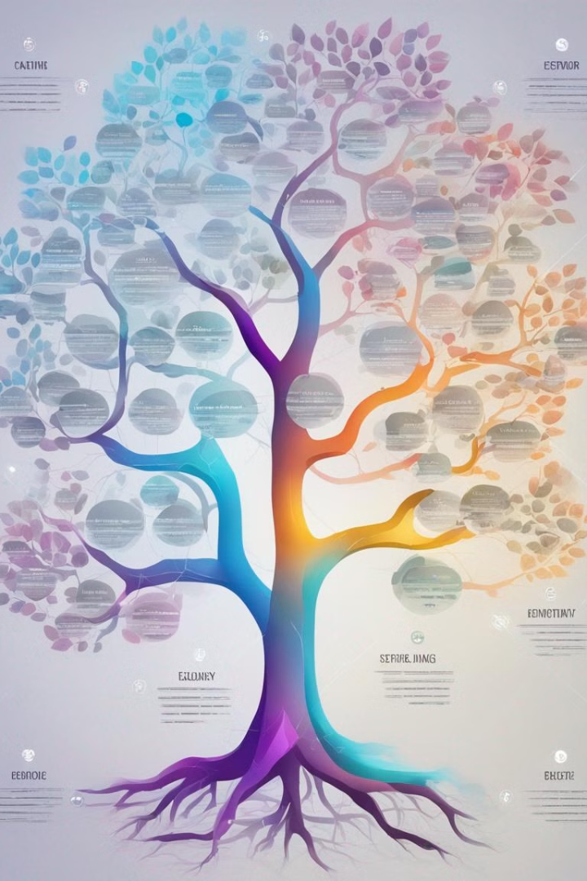
Conclusion and Key Takeaways
As we conclude our exploration of phylogenetics in bioinformatics, it's crucial to reflect on the key takeaways from this deep dive into evolutionary relationships, phylogenetic tree construction methods, sequence alignment, molecular clock and divergence time estimation, applications in bioinformatics, challenges, and tools utilized in this field.
We have discovered the pivotal role of phylogenetics in understanding the genetic relatedness, evolutionary patterns, and divergence times of species, and its applications in drug development, disease research, and conservation efforts. The challenges in phylogenetic analysis have underscored the importance of robust methodologies and data interpretation.
With the advent of advanced tools and techniques, we foresee a promising future in phylogenetics, opening new avenues for understanding and addressing complex biological questions.

